Slide 1



SMART STETHECOPE INTEGRATED WITH AI ASSISTANCE FOR TELEMEDICINE
DEPARTMENT OF ELECTRONICS AND COMMUNICATION ENGINEERING
PRESENTED BY
RAJEEV S A
LOKESHSARAVANAN G K
MALAVIKA V
VIGNESH E G
GUIDED BY
DR.P.SIVARANJANI
PROFESSOR
1

Slide 2
INTRODUCTION
The stethoscope has been an essential tool in medical practice for centuries, allowing healthcare professionals to listen to internal body sounds, particularly the heart and lungs
Traditional stethoscopes only allow for physical examination without the ability to record and playback heart and lung sounds, which is a significant limitation
To overcome this limitation , the Digital Stethoscopes is developed .It offers better sound quality with AI assistance, adjustable amplification, noise reduction and enabling remote monitoring and consultations

Slide 3
PROBLEM STATEMENT
The absence of an integrated digital stethoscope and accompanying web application equipped with AI-enabled sound analysis hampers modern healthcare practices
The current limitations in recording, analyzing, and transmitting lung sounds and AI-generated diagnostic results in real-time create barriers to remote patient monitoring, timely diagnosis, and collaborative medical consultations
This problem necessitates the development of a comprehensive solution that includes the creation of a functional digital stethoscope prototype
3

Slide 4
OBJECTIVE
Develop an integrated Smart digital stethoscope
Create a user-friendly web application with AI-enabled sound analysis for real-time diagnosis and remote patient monitoring in healthcare
4

Slide 5
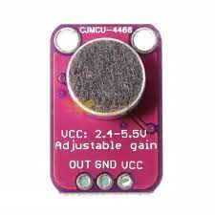
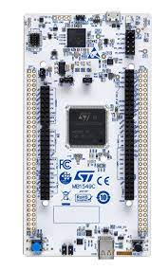


TECHNOLOGY AND TOOLS
STM32-U575ZI-Q
MAX4466 MICROPHONE
STETHOSCOPE
SDCARD MODULE
000WEBHOST
STM CUBE IDE
NANO EDGE AI STUDIO
FIG 1: MAX4466
FIG 2: STM CUBE IDE
FIG 4 STM32-U575ZI-Q
FIG 3: NANO EDGE AI STUDIO

Slide 6
EXISTING METHOD
The conventional stethoscope is a widely used medical instrument designed for auscultation, which is the process of listening to internal sounds of the body
( heart, lungs and blood vessels )
The conventional stethoscope is a standard medical tool used for decades in the field of medicine . It consists of earpieces, tubing, and a chest piece with a bell and a diaphragm
Healthcare providers insert the earpieces, place the diaphragm or bell on the patient's body, and listen for different frequencies by adjusting pressure. The stethoscope helps in identifying normal and abnormal sounds of patients

Slide 7
PROPOSED METHOD
The proposed auscultation platform consist of a digital stethoscope and microcontroller. The proposed method enables remote monitoring with AI and consultations through the data transmitted
This technology finds significant value in telemedicine and remote patient care, addressing traditional stethoscope deficiencies by incorporating a microphone to the chest piece
The heart sounds can be analyzed and AI assisted, particularly benefiting people in remote hill area

Slide 8
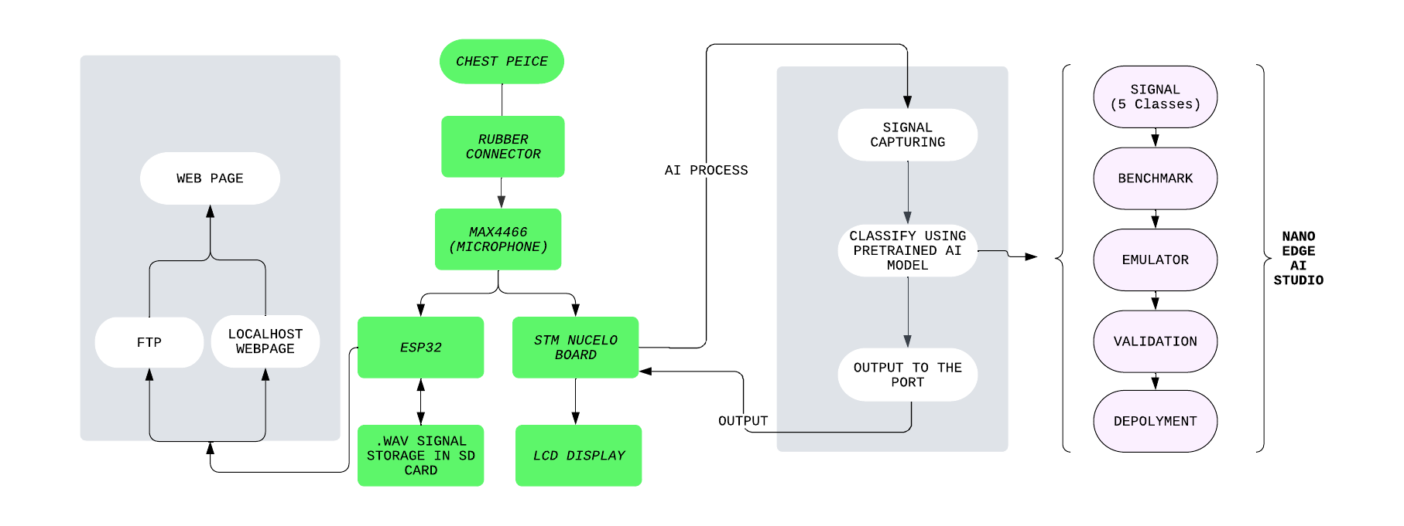
METHODOLOGY
FIG 5 : Block Diagram
8

Slide 9
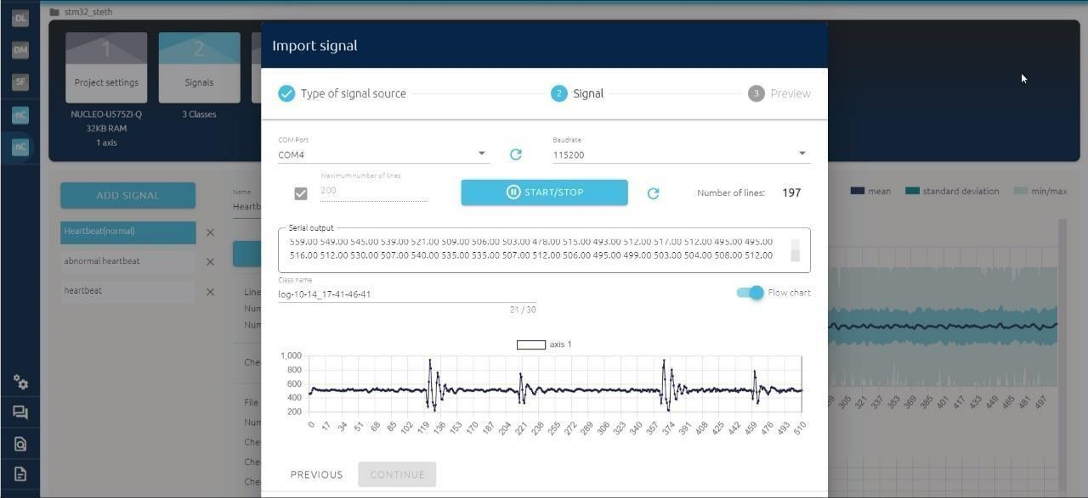
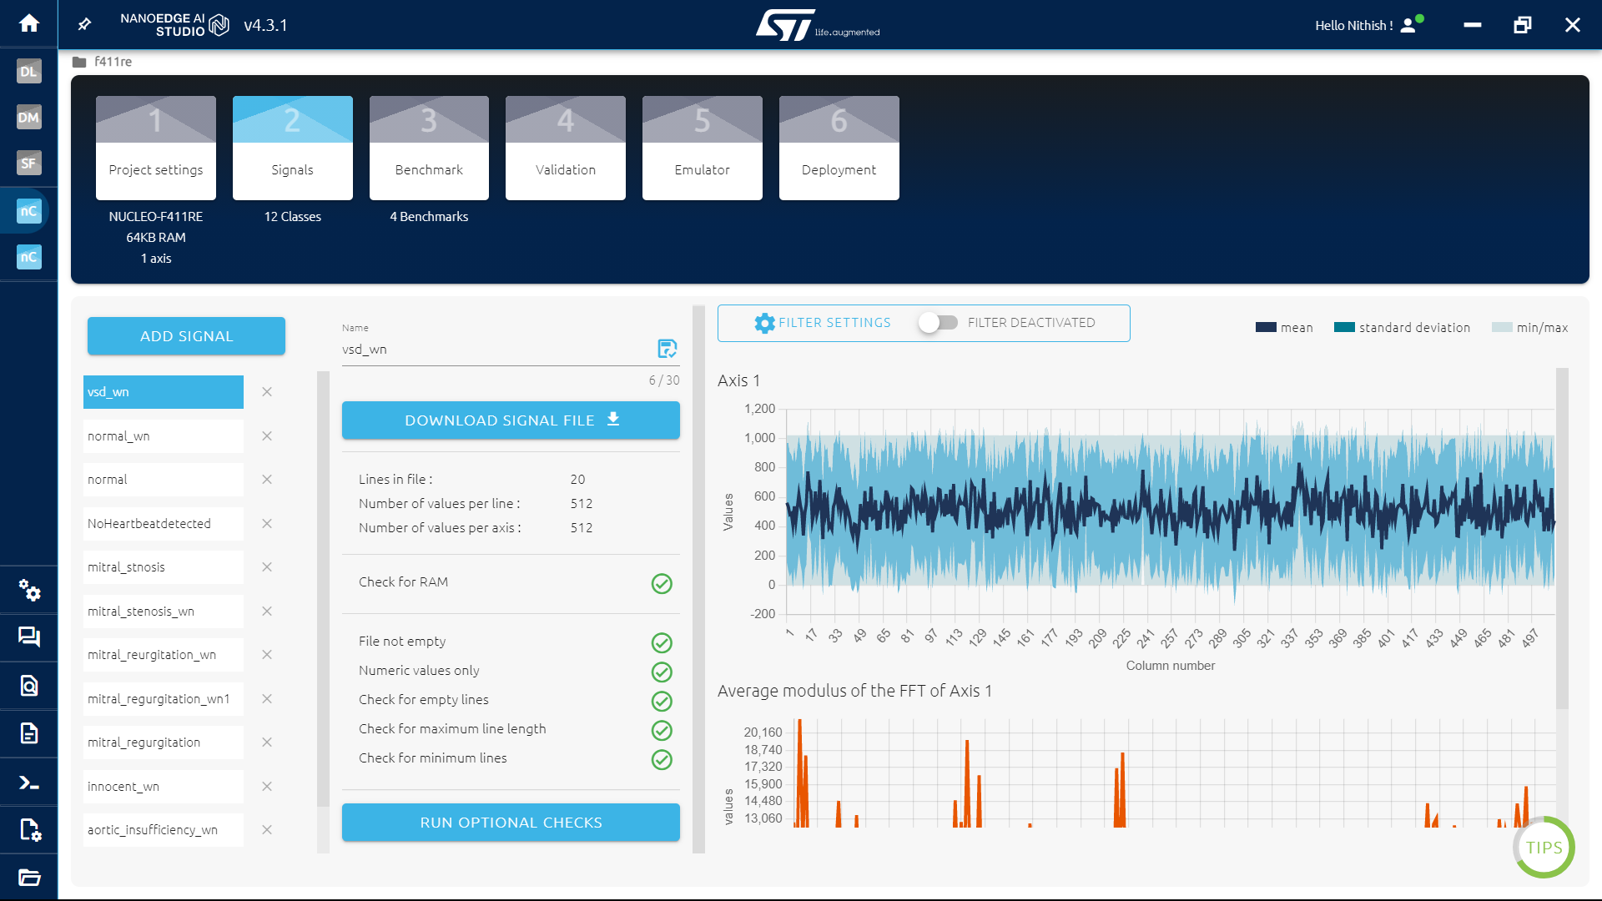
DATASET AND MODEL TRAINING
https://depts.washington.edu/physdx/heart/demo.html
Source: University of Washington of medicine advanced physical diagnosis learning and teaching heart abnormalities
FIG 6 Real Time Heart Beat Sampling
FIG 7 signal acquirement from files

Slide 10
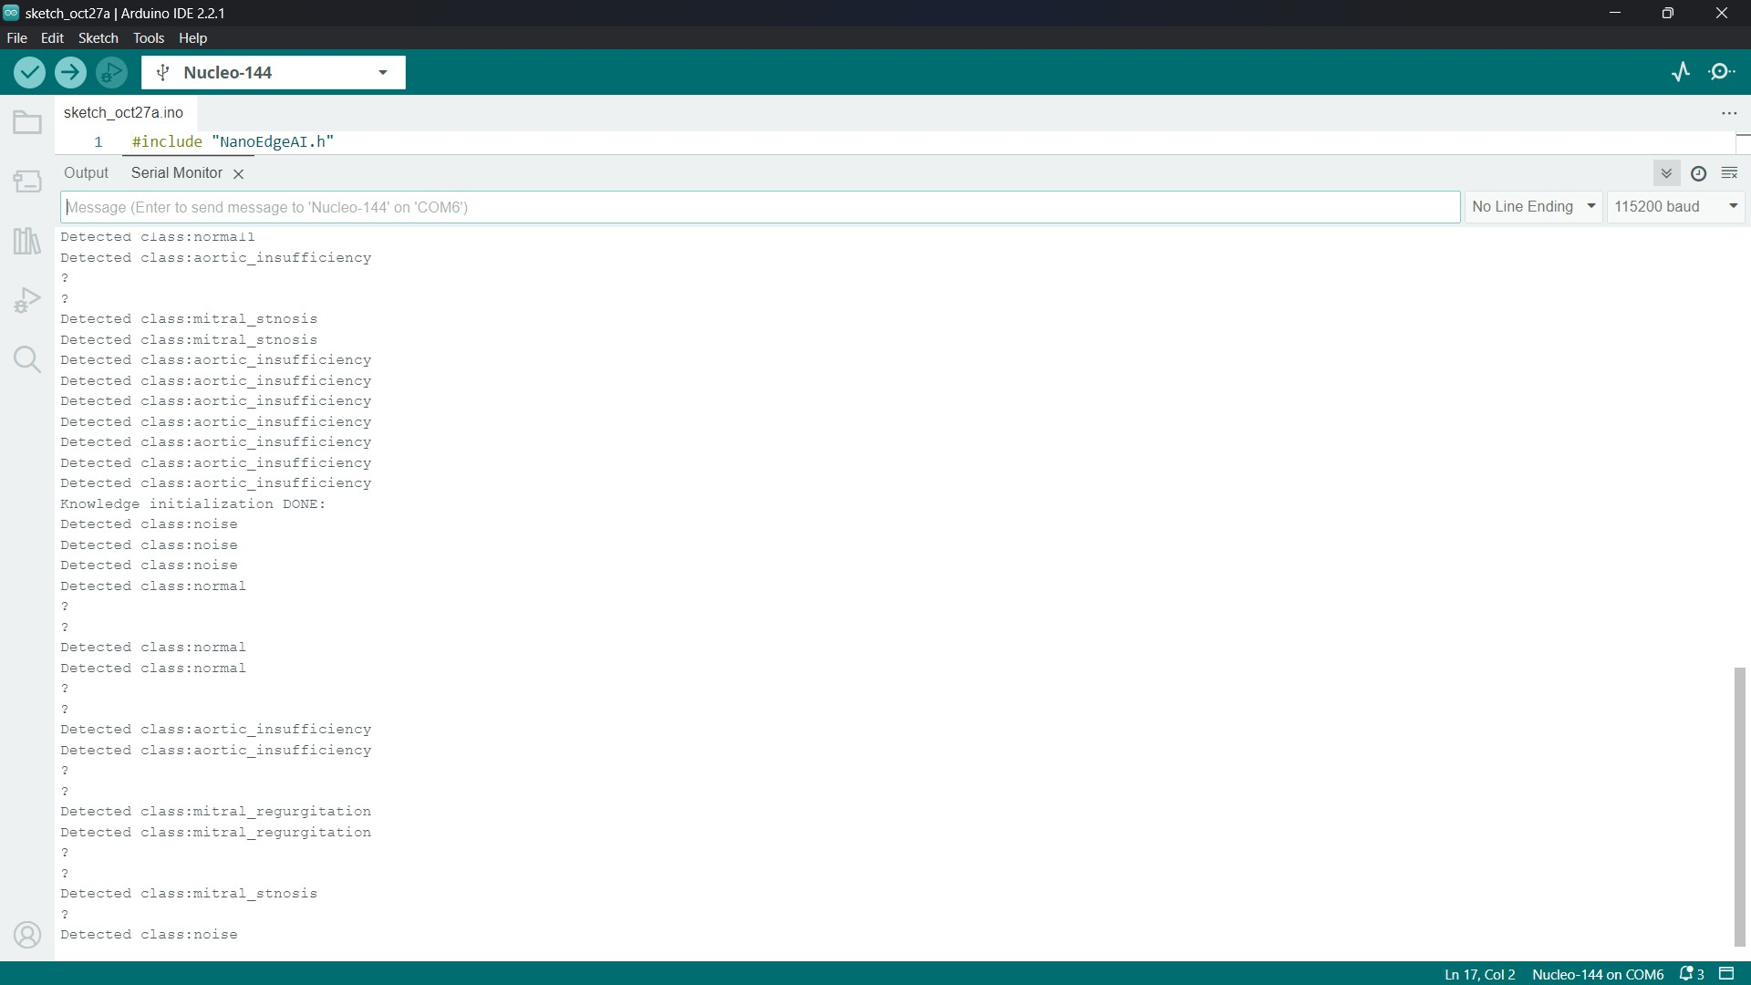
AI DETECTED RESULT
TABLE 1 : Heart abnormalities identified with their cause
S. No | Heart Abnormalities | Cause
1 | Ventricular Septal defect | A hole in the heart that's present at birth
2 | Mitral regurgitation | Mitral valve do not close properly, causing a backward flow of blood back to the heart
3 | Mitral stenosis | Narrowing of the valve between the two left heart chambers
4 | Aortic insufficiency | Aortic valve no longer functions adequately to control the flow of blood from L.V to R.V
5 | Innocent heart beat | Infancy and childhood Blood circulating normally through the heart's chambers and valves
FIG 6 : Serial Moniter Output For AI Detection

Slide 11
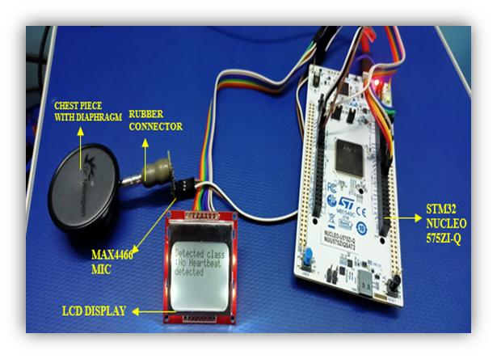
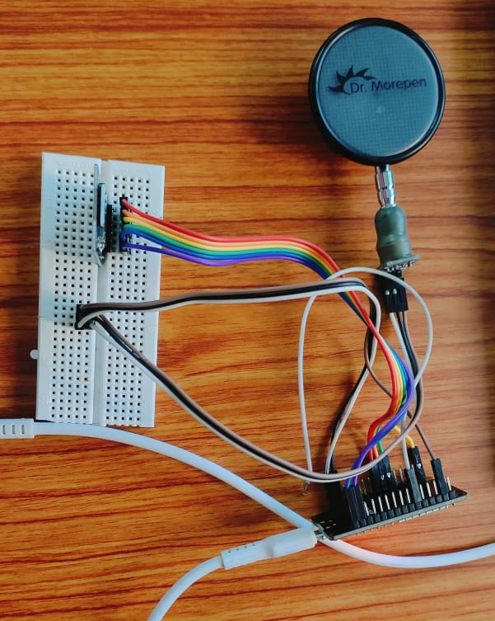
HARDWARE PROTOTYPE
FIG 8 : PROTOTYPE FOR HEARTBEAT ANALYSIS USING AI
FIG 9: PROTOTYPE FOR RECORD AND RECEIVE SIGNAL

Slide 12
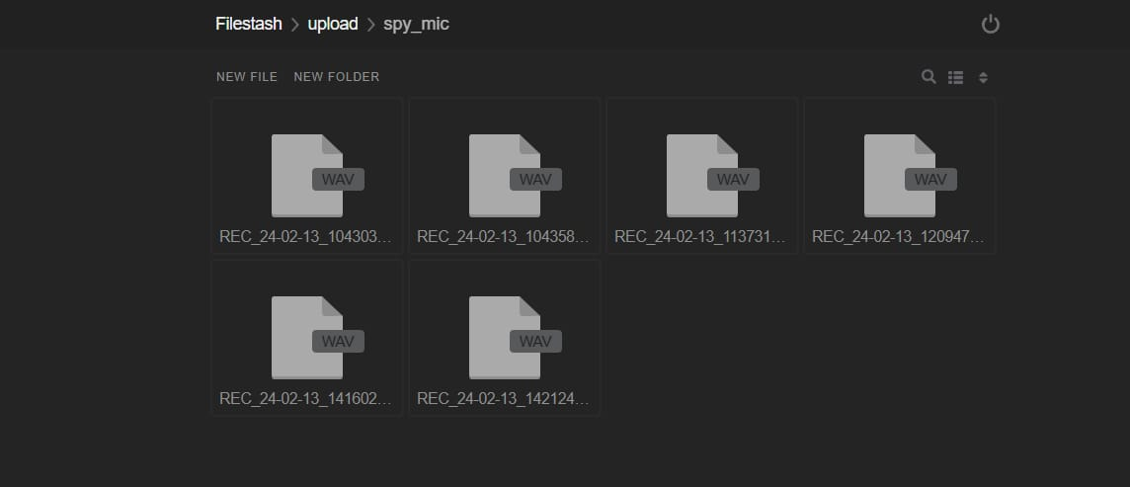
WAV FILE IN FTP FOLDER
WAV file contains three chunks of information
RIFF chunk (12 bytes)
FORMAT chunk (24 bytes)
DATA chunk contains the actual samples
FIG 11 : RECEIVED RECORDED FILES IN FTP FOLDER

Slide 13
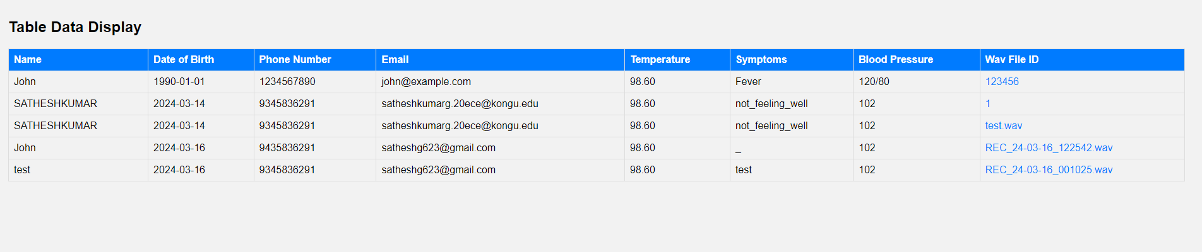
WEB APPLICATION
FIG 12 : RECEIVED RECORDED FILES IN WEB APPLICATION

Slide 14
CONCLUSION
The integration of hardware and software components allows for real-time data acquisition, preprocessing, and classification of heart sounds
By leveraging pre-trained AI models and continuous refinement, the system offers the potential for accurate and reliable detection of abnormalities
This also helps people live in remote areas to get expert doctor consultation through telemedicine
FUTURE WORK
With a greater variety of samples, the system can improve its capacity to effectively identify and differentiate a wider array of heart abnormalities with precision and reliability
extended range of disease classifications contributes to the system's value as a diagnostic tool, as it becomes more comprehensive and capable of addressing a broader spectrum of cardiac issues.

Slide 15
THANK YOU

